Slide 1
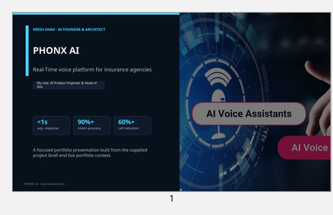
CLIENT-FACING PRESENTATION
PHONX AI
Real-time voice automation for insurance and other call-heavy operations
Krish Shah role: AI Product Engineer & Head of Dev
Voice AI platform that answers, qualifies, schedules, and syncs directly into business workflows.
<1s
90%+
60%+
avg response
intent accuracy
call reduction
Framed to help a client understand business value quickly and then go one layer deeper into fit, delivery, and implementation.
PHONX AI • client pitch
Notes:
[Sources]
- Krish Shah website context used throughout: home page lines 8-16, 79-133 and About page lines 8-27, 31-51 on https://krish-shah.de and https://krish-shah.de/about (opened 2026-04-11). Project details were also grounded in the uploaded PDF brief: WEBSITE CONTENT + PROJECT PRESENTATION BRIEF.pdf, pages 1-4.
- krish-shah.de/project_phonx lines 16-35, 47-94
- krish-shah.de lines 85-94
- WEBSITE CONTENT + PROJECT PRESENTATION BRIEF.pdf pages 1-2
- Internal visual derived from prior in-conversation deck asset: phonx_slide1.png / phonx_slide3.png

Slide 2
THE CLIENT PROBLEM
Why this matters
•
High inbound call load creates staffing pressure and missed opportunities.
•
Legacy IVR handles routing, not real conversations or compliance-safe answers.
•
As volume grows, quality drops unless headcount grows with it.
Best fit
Best fit for insurance agencies, appointment-driven teams, support centers, and sales ops where phone responsiveness directly affects conversion or service quality.
PHONX AI • problem and fit
Notes:
[Sources]
- Krish Shah website context used throughout: home page lines 8-16, 79-133 and About page lines 8-27, 31-51 on https://krish-shah.de and https://krish-shah.de/about (opened 2026-04-11). Project details were also grounded in the uploaded PDF brief: WEBSITE CONTENT + PROJECT PRESENTATION BRIEF.pdf, pages 1-4.
- krish-shah.de/project_phonx lines 16-35, 47-94
- krish-shah.de lines 85-94
- WEBSITE CONTENT + PROJECT PRESENTATION BRIEF.pdf pages 1-2
- Internal visual derived from prior in-conversation deck asset: phonx_slide1.png / phonx_slide3.png

Slide 3
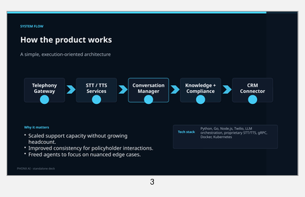
WHAT GETS BUILT
Solution view
A microservice-based voice automation system spanning telephony, speech services, reasoning, compliance enforcement, and CRM synchronization — built for sub-second, multi-turn conversations.
Telephony → STT/TTS → Conversation → Knowledge + Compliance → CRM Sync
Client outcomes
•
Turns phone operations into a scalable infrastructure layer.
•
Creates more consistent customer experiences across every call.
•
Lets human agents focus on exceptions and revenue-critical cases.
PHONX AI • solution view
Notes:
[Sources]
- Krish Shah website context used throughout: home page lines 8-16, 79-133 and About page lines 8-27, 31-51 on https://krish-shah.de and https://krish-shah.de/about (opened 2026-04-11). Project details were also grounded in the uploaded PDF brief: WEBSITE CONTENT + PROJECT PRESENTATION BRIEF.pdf, pages 1-4.
- krish-shah.de/project_phonx lines 16-35, 47-94
- krish-shah.de lines 85-94
- WEBSITE CONTENT + PROJECT PRESENTATION BRIEF.pdf pages 1-2
- Internal visual derived from prior in-conversation deck asset: phonx_slide1.png / phonx_slide3.png

Slide 4
HOW TO POSITION IT
From interest to delivery
01
02
03
Map live call flows
Pilot highest-volume intents
Roll out with CRM and compliance controls
Why this feels credible in a client conversation
•
Portfolio case study positions the system around real operational constraints, not a demo.
•
Metrics are framed around response time, accuracy, and reduced human call load.
•
The engagement naturally maps to discovery, pilot, and production rollout.
Portfolio context: krish-shah.de
PHONX AI • engagement path
Notes:
[Sources]
- Krish Shah website context used throughout: home page lines 8-16, 79-133 and About page lines 8-27, 31-51 on https://krish-shah.de and https://krish-shah.de/about (opened 2026-04-11). Project details were also grounded in the uploaded PDF brief: WEBSITE CONTENT + PROJECT PRESENTATION BRIEF.pdf, pages 1-4.
- krish-shah.de/project_phonx lines 16-35, 47-94
- krish-shah.de lines 85-94
- WEBSITE CONTENT + PROJECT PRESENTATION BRIEF.pdf pages 1-2
- Internal visual derived from prior in-conversation deck asset: phonx_slide1.png / phonx_slide3.png
- krish-shah.de/about lines 8-27, 31-51

